Slide 1
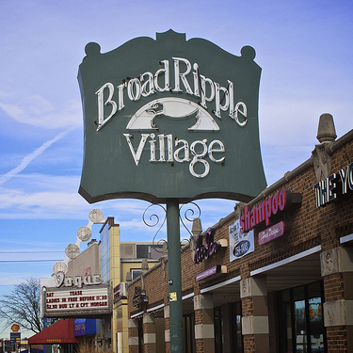
Broad ripple properties
An analysis of 46220

Slide 2

Theme
Visualize and bring to life properties within Broad Ripple from a data perspective using a large data file procured from Indiana State Public Records.

Slide 3

Coding Approach
Secured data
Brainstormed ideas
Settled on html page layout
Determined visualization types
Cleaned the data
Filled in missing information
Divided project

Slide 4
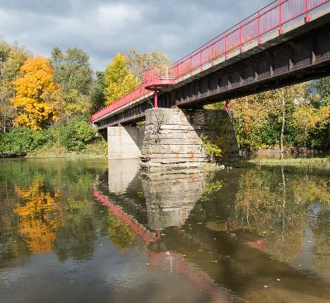
Data Munging Techniques
Reduced file size (1.6 GB -> 1.1 KB)
Eliminated irrelevant data
Secured coordinates for each property
Merged coordinates with cleaned data

Slide 5

AWS Services Used
AWS Redshift to store data
Based on PostgreSQL
AWS API Gateway to retrieve data remotely
AWS Lambda to process requests/bridge API Gateway to Redshift
Scalable databases to cut costs on smaller projects

Slide 6
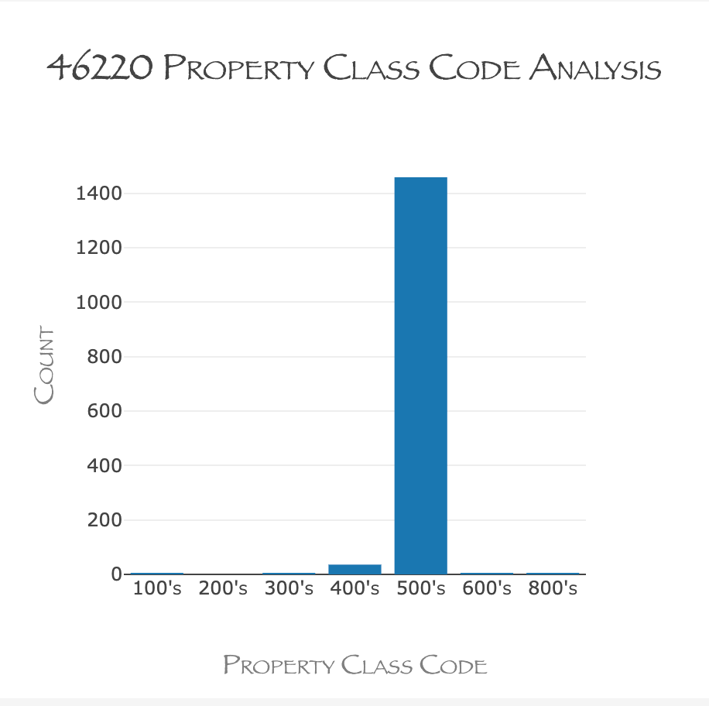
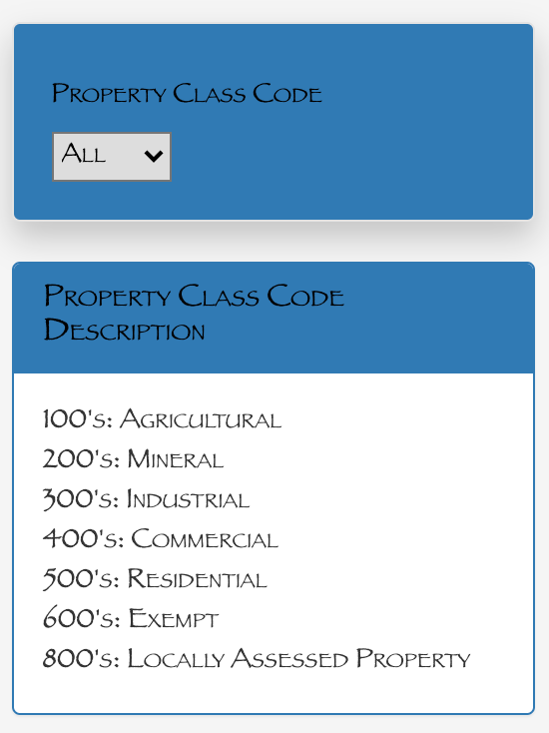
Property code breakdown
Notes:
510: RESIDENTIAL ONE FAMILY DWELLING ON A PLATTED LOT
420: COMMERCIAL SMALL RETAIL
447: COMMERCIAL OFFICE BUILDING 1 OR 2 STORY

Slide 7
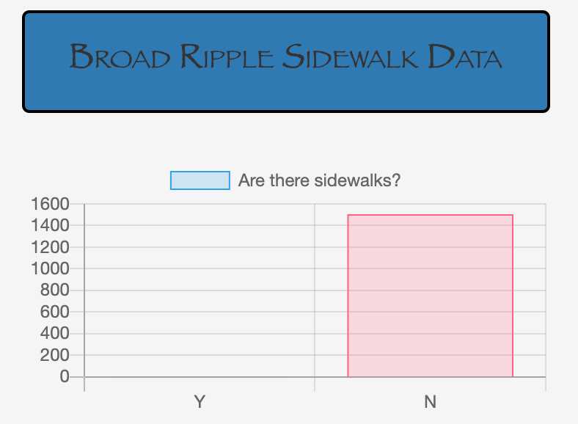
Pedestrian friendly broad ripple
New JS Library
Chart.JS
Lots of functionality to make interactive charts of all kinds
8 chart types
Automatically resizes charts to window size
Easy to use!

Slide 8
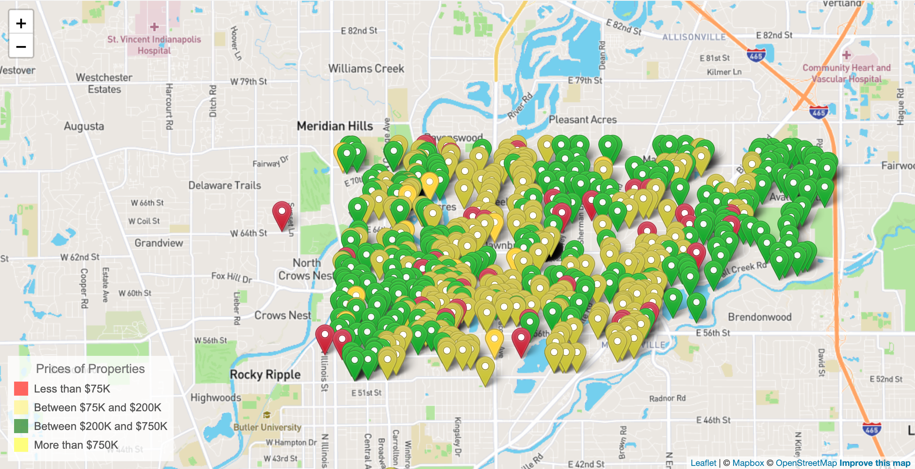
46220 Property listings by value

Slide 9
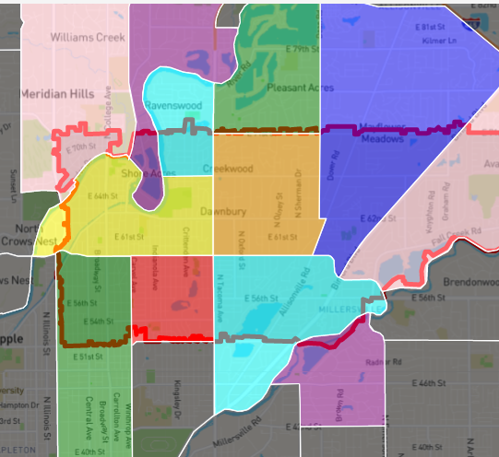
The Neighborhoods of 46220
Broad Ripple
Glendale
Meridian Kessler
Canterbury-Chatard
Allisonville
Devonshire
Millersville
North Central
Meridian Hills/Williams Creek
Ravenswood
Clearwater
I-69/Fall Creek
Devon

Slide 10





Jackson Yaggi
Katie schuman
Data Analyst
Data Analyst
Helena o’farrow
Tim marlett
Nathan prows
Data Analyst
Data Analyst
Data Analyst
Senior member of Group two. You can call me Pops.
10

Slide 11
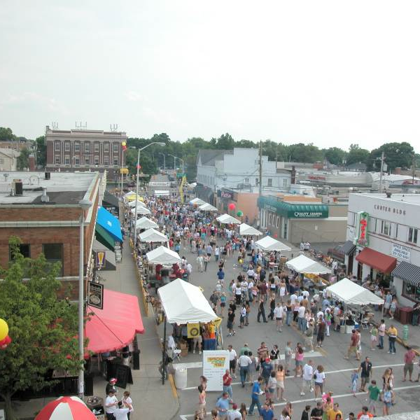
Thank you!
GitHub Repo

